Slide 1



Coleridge Initiative - Show US the Data
Winner’s Presentation
Team ZALO FTW
Notes:
Recommending picking out he most interesting and important parts from your documentation.

Slide 2
Agenda
Background
Competition Overview
Solution Summary
Preprocessing
Modeling
Post-processing
Question and Answer

Slide 3
Background
Khoi Nguyen, Data Scientist @ Zalo, VNG
Nguyen Quan Anh Minh, AI Engineer @ Zalo AI, VNG

Slide 4
Competition Overview
Goal:
Identify data sets used in scientific publications
Challenges:
Partially labeled training set
Limited amount of unique labels
Unreliable validation
Unreliable public leaderboard
F0.5 metric

Slide 5
Solution Summary

Slide 6
Summary
Key idea was to use the context information instead of the very limited unique labels.
Submitted two solution separately:
Winning solution with metric learning (this presentation)
Could’ve-been 3rd solution with causal language model, described here
Pre and post-processing to normalize labels and predictions
Relying on Huggingface’s transformers and spacy

Slide 7
Preprocessing

Slide 8
Preprocessing
Detecting possible false-negatives
Using spacy’s AbbreviationDetector to detect substrings with pattern like FULL-NAME (ABBREVIATION) that contained specific keywords (Dataset, Database, Study, Survey .etc).
For example: National Education Longitudinal Study (NELS)
Looking forward/backward from that keyword until we meet two consecutive lowercase words.
Ones that have a Jaccard similarity of 0.5 or greater with any of the original train labels will be used for training, the rest will be passed to validation.
Labels normalization
If FULL NAME (ABBREVIATION) is found → add FULL NAME and ABBREVIATION to the list of labels.
If only FULL NAME is found → add its ABBREVIATION if mentioned.
Remove from training any sample that contained any label that belonged to both the training and validation set.

Slide 9
Modeling

Slide 10
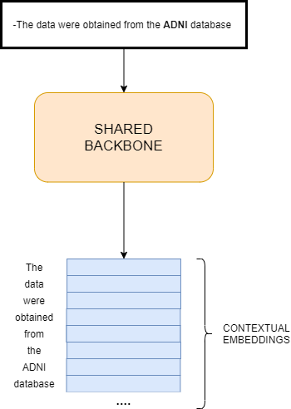
Transformer Language Models
A core component of our solution is the popular transformer model, more precisely the BERT architecture
Intuitively, the model will be able to map each token in the input text to a vector (an embedding).
The representations of the same word will be altered based on the context surrounding it i.e. contextual embedding

Slide 11
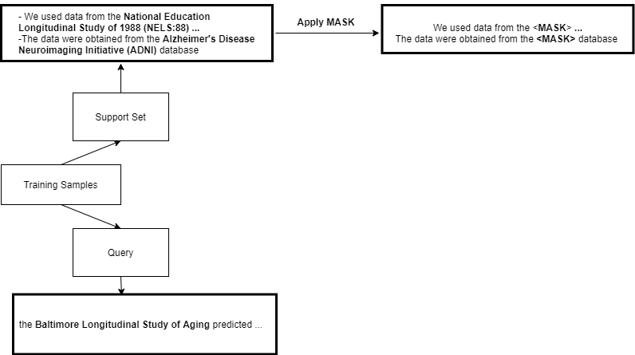
Query & Supports
Training samples: Overlapping chunks of text, each chunk contains 250 words at most.
Query: our interest - a chunk of text that potentially contains the dataset titles we want to extract.
Support set: a set of samples with annotated labels.
With a new query, we want to look at the support set for any sample(s) with similar pattern
Since we knew where the datasets are supposed to be in the support sample, we can extract it from the query

Slide 12
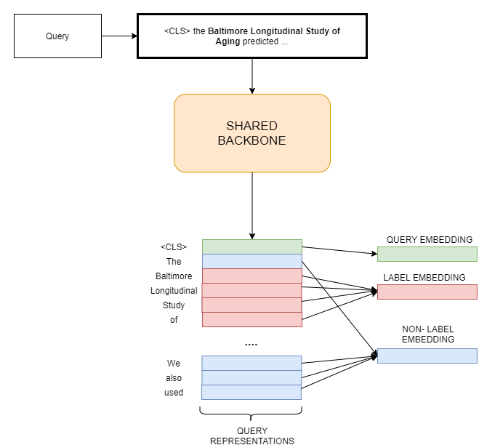
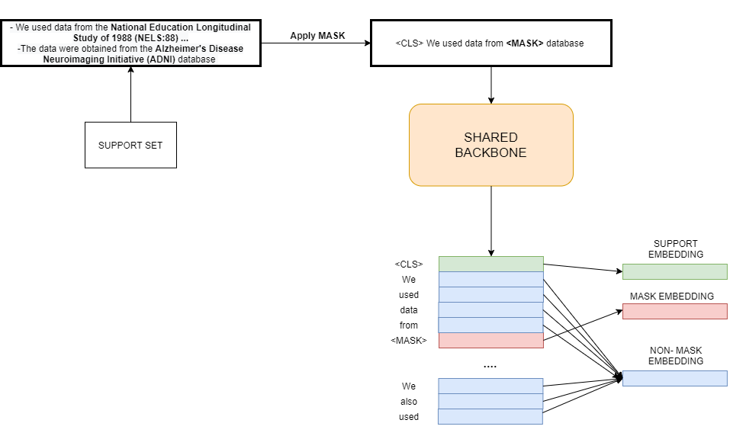
Embeddings Extraction
Query Embeddings Extraction
Support Embeddings Extraction

Slide 13
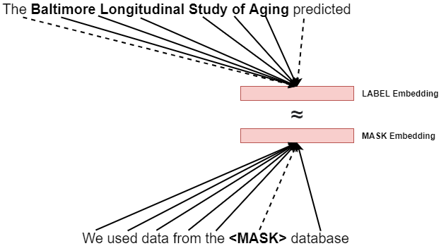
LABEL vs MASK embedding
Since <MASK> is a generic token that has no meaning by itself, the MASK embedding would contain a rich amount of information about the context.
On the other hand, the label itself has very distinct meaning regardless of the context.
By forcing the MASK and LABEL embedding to be close together, we were forcing the model to attend more to the surrounding context when looking at every label token.

Slide 14
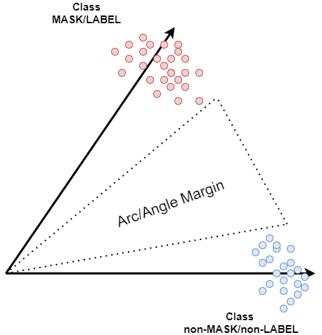
ArcFace Loss
Instead of using Softmax for classification, we use the ArcFace loss function.
ArcFace is usually used in face recognition tasks
Can enforce higher similarity for intra-class samples (same class samples) and diversity for inter-class samples (different class samples)

Slide 15
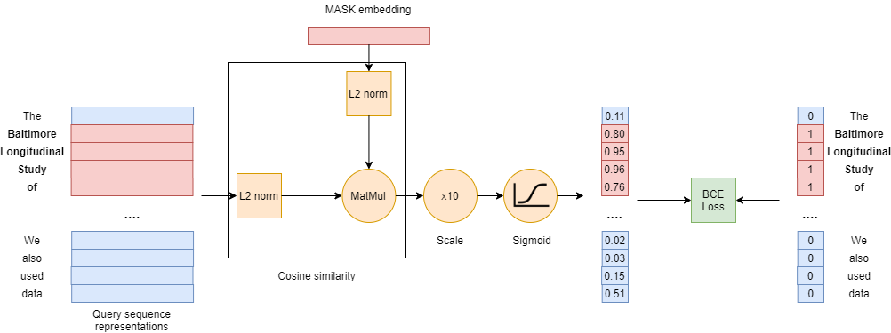
Token Classification

Slide 16
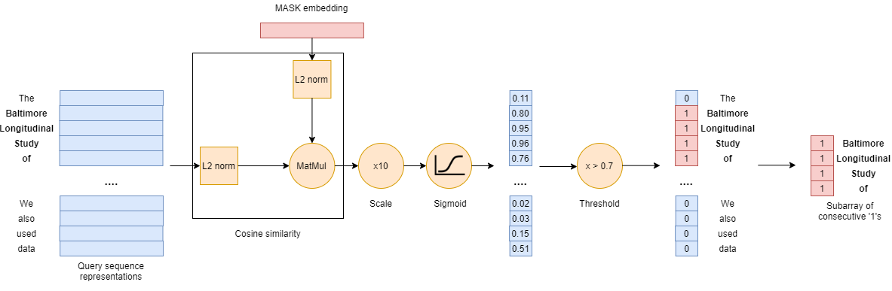
Inference

Slide 17
Training methods
Batch size = 4, support set size = 3 for training and 100 for inference.
⅛ of negative samples are used for training.
AdamWeightDecay optimizer with WarmUpPolynomialDecay learning rate scheduler
Augmentations:
Random label swapping: Using replacements from RCDatasets and the old competition dataset
Random word dropping: Drop the last word from the dataset name if it was an abbreviation.
Random lowercasing: Convert the dataset name to lowercase but keep the ACRONYM intact.
Final solution was an ensemble of two transformers BioMed-RoBERTa and SciBERT-base by unionizing their predictions.

Slide 18
Post-processing

Slide 19
Post-processing
Invalid predictions
Contains incomplete words .e.g "al Study of Youth" from "We used the data from the National Study of Youth"
Contains less than 3 words or less than 10 characters
Frequency threshold
Only take predictions that appear at least twice in the corpus.
The solution is not very sensitive to this threshold.
Database of dataset titles
Storing all valid predictions in a database.
Re-matching these titles with the test data to cover anything the model may have missed.
Abbreviations detection
If a dataset title is found, we also add its abbreviation to predictions.
Removing known labels from prediction to better assess real performance

Slide 20
Question and Answer

